Slide 1
Development during the post-conflict period in the South Caucasus:
International perspectives on the role of education infrastructure in peace-building and regional economic development
R. Lizzie Wahab

Slide 2
VP Enrollment Management
Turbo-courses
Supply-chain logistics (SUNY Adirondack)
Business Analytics (Franklin Pierce U. for Southeast Asia diaspora)
International Academic Profile
AVP – New Programs
Fire Science Management
Fire Protection Engineering Programs
Art and Design for the Arab Diaspora
Project Manager
Criminal Justice
Security Studies
Intelligence Studies

Slide 3
Azerbaijan’s Commitment to Higher Education (% Budget, 2006 – 2019, Source = World Bank)
Consistent Commitment to Higher Education Investment
(Note: Data is only pre-pandemic)

Slide 4
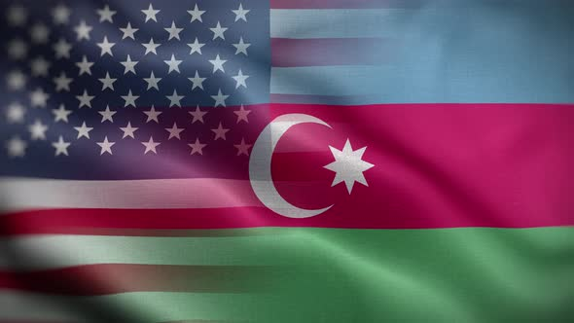
Vision and Mission
@Confluence of
Cultures
Implementation of an Azerbaijani Higher Education Peacebuilding Strategy can be found in the confluence of three thematic clusters:
Emphasis on entrepreneurship after higher education abroad through Innovation Hubs at Azerbaijani universities via a modified American model
Developing long-term Higher Education Research Infrastructure in Azerbaijan (a “Big Bet” perspective)
Exhaustive study of education-research-communication infrastructure needed for a dual education-diplomacy role:
Case Study of Qatar Education City and Qatar’s “Soft Power”

Slide 5
A vision for “Big Bet” knowledge economy development for Azerbaijan
Innovation
Research Infrastructure
Mission
“Azerbaijan will establish new academic programs that all centralize the principles of data science, supported by an internationally-renowned Institute for the Advanced Study of Data Realization to study the core problems and solutions to unlock the full potential of this new science.“
Professional Programs
Vision
“Azerbaijan will be a leading institution of higher education the application of Data Science to economic development that enhances regional security.”
Post-Graduate Innovation
Research Infrastructure
Applying education and research to in-country innovation
Professional Programs
Data Science focus
Driven by student demand and local/regional needs

Slide 6
Azerbaijani Graduate Students and international students will be incentivized to in-country through enhanced Innovation Hubs
The National Science Foundation (NSF) announced this week that, as part of its Innovation Corps, (I-Corps™) program, it will establish five I-Corps Hubs. Each hub, funded at $3 million a year for five years for a total of $15 million per hub, will be headed by a lead university and involve an alliance of at least eight universities. While most of the participating institutions are large research universities, two of the hubs also include a Historically Black College and University.
The goal of the hubs is to scale up the National Innovation Network and provide experiential entrepreneurial training to academic researchers across all fields of science and engineering. The hubs will enable researchers to translate basic research results into products that can be brought to the marketplace. According to the NSF news release, the hubs are also expected to “work collaboratively to build and sustain a diverse and inclusive innovation ecosystem throughout the U.S.”
"For 10 years, the NSF I-Corps program has been critical to fostering the creative spirit and entrepreneurship that enables NSF-funded research to be translated into new products and services and contribute to the nation's economy," said NSF Deputy Assistant Director for Engineering Linda Blevins. "I am delighted to launch the first of our I-Corps Hubs, which will form the foundation for strengthening and scaling this innovation ecosystem. The I-Corps Hubs will bring together diverse scientists and engineers, entrepreneurs, business leaders and industry partners from every part of our country, providing everyone with an opportunity to solve key challenges and spur economic growth, including new startups and new jobs."

Slide 7
Vision and Mission
@Confluence of
Cultures
Azerbaijani Innovation Hubs will extend the mission of commercialization offices already in place in Azerbaijani universities:
Provide competitive research grants to recent graduates for early-stage business / product development
Technology transfer services for graduates with more mature, market-ready ideas.
Prototyping services via coders and/or fabrication
Facilitate diaspora- and other investor agreements with graduates via a formal development/fundraising arm of each Innovation Hub

Slide 8
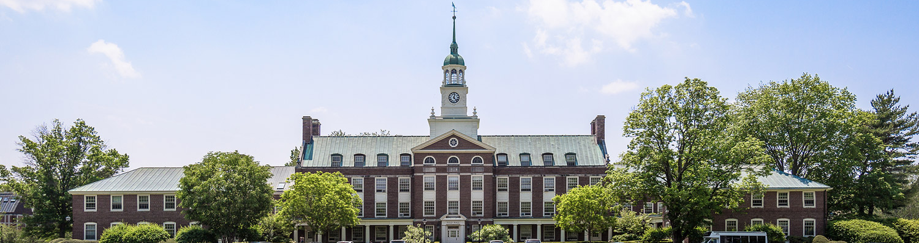
Institute for the Advanced Study of Data Realization
Biggest Bet: Research Infrastructure
Modeled after Princeton University’s Institute for Advanced Study (IAS)
“The Institute is pledged to assemble a group of scientists and scholars who with their pupils and assistants may devote themselves to the task of pushing beyond the present limits of human knowledge and to training those who may "carry on" in this sense.”
––Mission statement of the IAS by founding Director Abraham Flexner, Organization Meeting, October 10, 1930
From IAS’s website:
The Institute for Advanced Study is one of the world’s leading centers for curiosity-driven basic research. Since 1930, it has served as a model for protecting and promoting independent inquiry, prompting the establishment of similar institutes around the world, and underscoring the importance of academic freedom worldwide. Current philanthropic support and a reliable stream of endowment-generated revenue allow its permanent international Faculty and visiting researchers.

Slide 9
Top Data Science Research Questions for an IAS-Data of Azerbaijan
Scientific Understanding of Deep Learning Algorithms
Causal Reasoning in place of unrestrained correlational analysis
Integrating Multiple, Heterogeneous Data Sources to bound uncertainty
Building Trustworthy AI
From:
Wing, J. M. (2020). Ten Research Challenge Areas in Data Science. Harvard Data Science Review, 2(3). https: //doi.org/10.1162/99608f92.c6577b1f

Slide 10
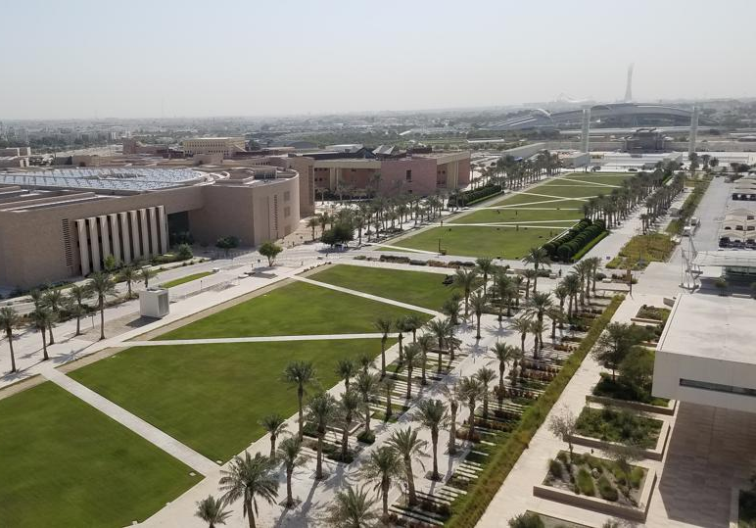
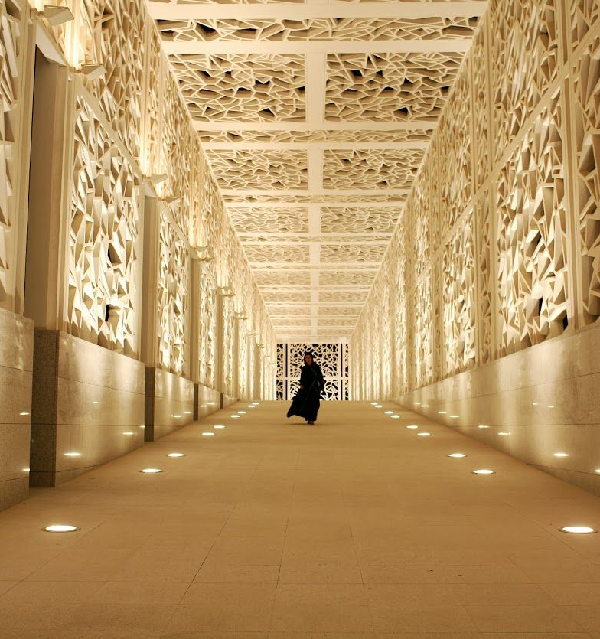
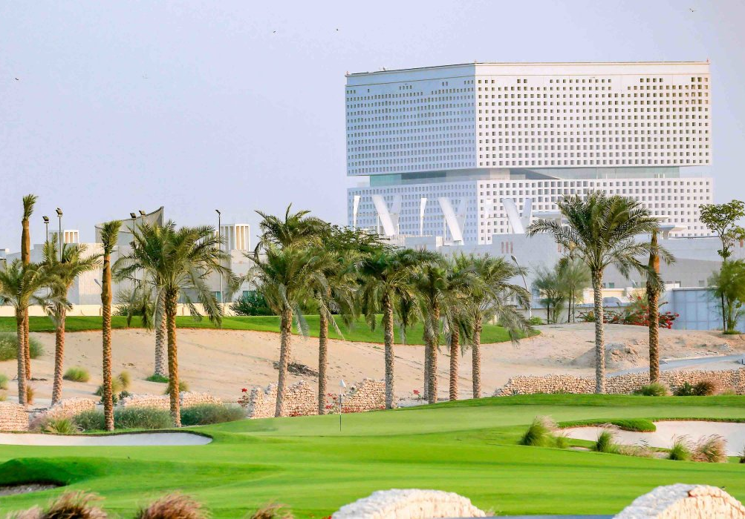
Education Leveraged for Peace:
One Arrow in the Soft-Power Quiver
Qatar’s Soft Power and its Own Security in a Dangerous Neighborhood
Qatar leverages for influence:
Aljazeera Network (Georgetown-Q, Northwestern-Q)
Doha Film Institute (Northwestern-Q)
Sports investments
Foreign aid policy
Case Study: Kingdom of Qatar
Launched in 1998, Education City hosts eight renowned international universities offering programs in Engineering, Medicine, Foreign Service, Arts, Journalism, Business, Information Sciences, Computer Science PLUS research centers and an innovation hub.
Qatar positioned itself a regional mediator and promoter of peace in a highly fractious area by leveraging Education in combination with News Media, Sports, & Film to become the fulcrum of the Middle East.
Summary
Competence in the exercise of soft power is supported by educational infrastructure, and as each of these efforts has matured, it has enabled Qatar to expand to overseas acquisitions in each industry (media, sport, film)
Competence in the exercise of soft power has attracted strong allies, with material support from the United States, UK, and Turkey to ensure Qatar’s sovereignty and promote peace even as it is surrounded by jealous rivals.

Slide 11
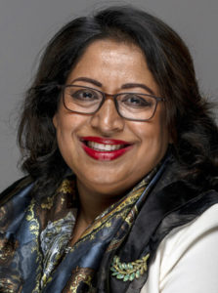
Vision and Mission
@Confluence of
Cultures
Implementation of an Azerbaijani Soft Power Strategy begins with an education and research infrastructure that:
Attracts faculty, students, and investors of a global caliber for long term investment, which in turn . . .
. . . makes Azerbaijan an attractive destination to industry-leading figures to visit. Baku can expand its scope of diplomatic ventures, NGO-driven conferences, research and knowledge industry symposia
Remember This: To be a purveyor of soft power, you must make that “Big Bet.” I recommend your Big Bet be an investment to become a dominant force in all aspects of Data Science (Qatar’s choice in the 90s was sporting events), but whatever you finally choose, you must make your mark on a global stage. I doubt that will be possible without a robust educational base.

Slide 12
Conclusions: “Our vision for Azerbaijan Higher Education must incorporate the building blocks of economic development in a global knowledge economy with proactive outreach to international partners to promote long-term peace and stability in the South Caucasus. Such an infrastructure must incentivize invention/commercialization and intentional peacebuilding through educational institutions and the media; attracting investment from the Azerbaijani diaspora and more generally from abroad” - Lizzie Wahab

